Slide 1
Confusion Matrix
In the field of machine learning and specifically the problem of statistical classification, a confusion matrix or an error matrix that allows visualization of the performance of an algorithm in supervised learning .
A confusion matrix is a table that is often used to describe the performance of a classification model (or "classifier") on a set of test data for which the true values are known.
In unsupervised learning it is usually called a matching matrix.
Calculating a confusion matrix can give you a better idea of what your classification model is getting right and what types of errors it is making.

Slide 2
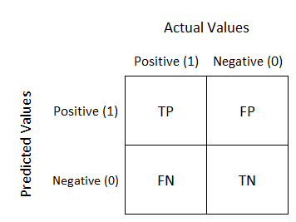
Confusion Matrix
True positives (TP): These are cases in which we predicted yes (they have the disease), and they do have the disease.
True negatives (TN): We predicted no, and they don't have the disease.
False positives (FP): We predicted yes, but they don't actually have the disease. (Also known as a "Type I error.")
False negatives (FN): We predicted no, but they actually do have the disease. (Also known as a "Type II error.")

Slide 3
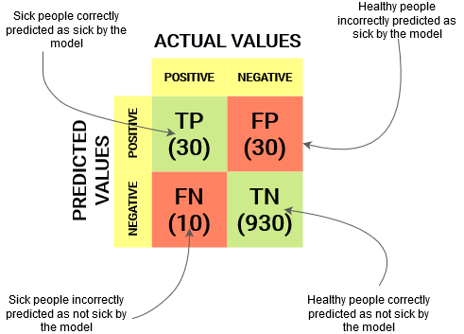
Confusion Matrix
There are two possible predicted classes: “positive" and “negative". If we were predicting the presence of a disease, for example, “positive" would mean they have the disease, and "negative" would mean they don't have the disease.
The classifier made a total of 1000 predictions (e.g., 1000 patients were being tested for the presence of that disease).
Out of those 1000 cases, the classifier predicted "yes" 60 times, and "no" 940 times.
In reality, 40 patients in the sample have the disease, and 960 patients do not.

Slide 4
Evaluation metrics
Accuracy: Overall, how often is the classifier correct?
(TP+TN)/(TP+FP+TN+FN) = (30+930)/1000 = 0.96
Misclassification Rate: Overall, how often is it wrong?
(FP+FN)/ (TP+FP+TN+FN )= (30+10)/1000 = 0.04
equivalent to 1 minus Accuracy
also known as "Error Rate"
True Positive Rate (TPR): When it's actually yes, how often does it predict yes?
TP/actual positive =TP/(TP+FN)= 30/(30+10) = 0.75
also known as "Sensitivity" or "Recall"
False Positive Rate (FPR): When it's actually no, how often does it predict yes?
FP/actual no= FP/(FP+TN) = 30/(30+930) = 0.03125

Slide 5

Evaluation metrics
True Negative Rate (TNR): When it's actually no, how often does it predict no?
TN/actual no = TN/(FP+TN) = 930/(30+930) = 0.96875
equivalent to 1 minus False Positive Rate
also known as "Specificity"
Precision: When it predicts yes, how often is it correct?
TP/predicted yes = TP/(TP+FP)= 30/(30+30) = 0.60
Also known as “positive predictive value (PPV).
Prevalence: How often does the yes condition actually occur in our sample?
actual yes/total =(TP+FN)/(TP+FP+FN+TN)= 40/1000 = 0.04
Null Error Rate: This is how often you would be wrong if you always predicted the majority class. (In our example, the null error rate would be 960/1000=0.96 because if you always predicted yes, you would only be wrong for the 960 "no" cases.)
F1- Score: This is a weighted average of the true positive rate (recall) and precision.

Slide 6
Evaluation metrics
Micro average is the precision/recall/f1-score calculated for all the classes.
Micro average= TP+TN/(TP+TN+FP+FN)
Macro average is the average of precision/recall/f1-score.
Micro average Precision = (Precision of class 1+Precision of class 2)/2
Weighted average is just the weighted average of precision/recall/f1-score.
Weighted average Precision = Precision of class 1* (no of instance in class 1/Total no of instance) + Precision of class 2* (no of instance in class 2/Total no of instance)

Slide 7
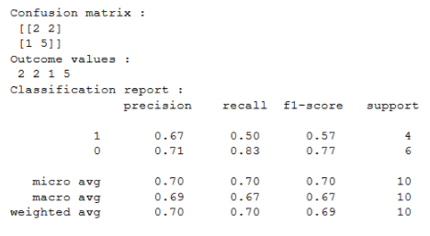
Evaluation metrics
For Example:

Slide 8

Evaluation metrics
Negative predictive values (NPV):The negative predictive values is the proportions of negative results in statistics tests that are true positive and true negative results, respectively.
False omission rate (FOR):
The complement of the NPV is the false omission rate (FOR)

Slide 9

Evaluation metrics
Cohen's Kappa: This is essentially a measure of how well the classifier performed as compared to how well it would have performed simply by chance. In other words, a model will have a high Kappa score if there is a big difference between the accuracy and the null error rate.
ROC Curve: This is a commonly used graph that summarizes the performance of a classifier over all possible thresholds. It is generated by plotting the True Positive Rate (y-axis) against the False Positive Rate (x-axis) as you vary the threshold for assigning observations to a given class.
AUC : It stands for "Area under the ROC Curve." That is, AUC measures the entire two-dimensional area underneath the entire ROC curve (think integral calculus) from (0,0) to (1,1).

Slide 10
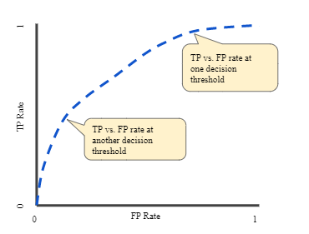
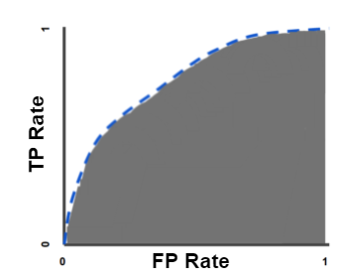
Evaluation metrics: ROC
ROC Curve
AUC

Slide 11


Evaluation metrics
Jaccard index:The Jaccard index, also known as the Jaccard similarity coefficient, is a statistic used for gauging the similarity and diversity of sample sets.
Matthew's correlation coefficient (MCC): The Matthews correlation coefficient (MCC) or phi coefficient is used in machine learning as a measure of the quality of binary (two-class) classifications

Slide 12
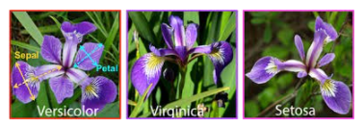
Evaluation metrics: Confusion matrix for a 3 Class classification
The IRIS DATASET has 3 flowers as outputs or classes, Versicolor, Virginia, Setosa.
FN: The False-negative value for a class will be the sum of values of corresponding rows except for the TP value.
FP: The False-positive value for a class will be the sum of values of the corresponding column except for the TP value.
TN: The True Negative value for a class will be the sum of values of all columns and rows except the values of that class that we are calculating the values for.
TP: The True positive value is where the actual value and predicted value are the same.

Slide 13
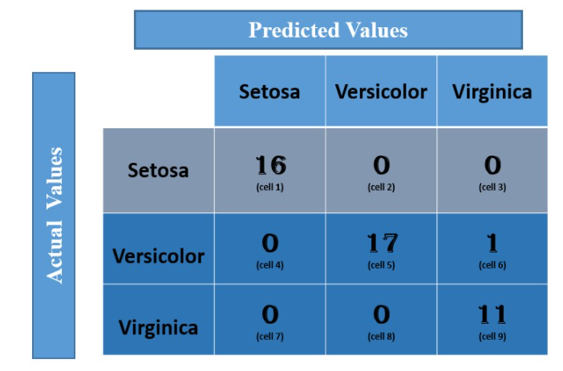
Evaluation metrics: Confusion matrix for a 3 Class classification

Slide 14
Evaluation metrics: Confusion matrix for a 3 Class classification
First calculate the TP, TN, FP, FN values for the class Setosa
TP: The actual value and predicted value should be the same. So, concerning Setosa class, the value of cell 1 is the TP value.
FN: The sum of values of corresponding rows except the TP value
FN = (cell 2 + cell3)
= (0 + 0)
= 0
FP : The sum of values of corresponding column except the TP value.
FP = (cell 4 + cell 7)
= (0 + 0)
= 0
TN: The sum of values of all columns and row except the values of that class that we are calculating the values for.
TN = (cell 5 + cell 6 + cell 8 + cell 9)
= 17 + 1 +0 + 11
= 29

Slide 15
Evaluation metrics: Confusion matrix for a 3 Class classification
Similarly, for Versicolor class the values/ metrics are calculated
TP : 17 (cell 5)
FN : 0 + 1 = 1 (cell 4 +cell 6)
FP : 0 + 0 = 0 (cell 2 + cell 8)
TN : 16 +0 +0 + 11 =27 (cell 1 + cell 3 + cell 7 + cell 9).

Slide 16

Thank you

